Slide 1
BRAIN TUMOR DETECTION USING K-MEANS CLUSTERING
Done by,
G.DHARANI [15EUIT024]
S.DHIVYA BHARATHI [15EUIT028]
B.N.FAHEEN FATHIMA [15EUIT030]
S.HINDU SREENI [15EUIT040]

Slide 2
OBJECTIVE
The main objective of this project is,
Processing an MRI image
Segmentation of the MRI image of brain
Clustering the MRI image
Identifying tumor in the image
Calculating the tumor size if tumor is present

Slide 3
INTRODUCTION
Medical image segmentation has been one of the most important fields where technology is blooming. In this paper, we propose a system where magnetic image of brain is segmented using unsupervised learning and clustered for identification and detection of tumor. The image is spilt into number of clusters using color-based centroids which is further segmented to identify the tumor in the segment. Furthermore, the specified image is processed to form a binary image where the size of tumor is found.
Thus the MRI of brain is processed using segmentation and K-Means clustering to separately analyze the area of interest in the images.

Slide 4
EXISTING SYSTEM
The medical image segmentation has become current research topic in the domain of data mining. Recently This research work mainly focused on Clustering method, specifically K-means algorithm. This algorithm has been implemented and tested with MRI of Human Brain. It can get advantages of the k-means in the aspects of easy understanding and study of brain tumors.
DISADVANTAGES:
Does not provide the size of the tumor
Does not provide the binary image of the tumor
Provides visual recognition alone

Slide 5
PROPOSED SYSTEM
Here we propose a new application for image segmentation in the field of medical diagnosis where the diagnosis of brain tumor is done using clustering algorithm . The magnetic resonance imaging of brain is provided from which we segment and slice the brain image using k-means algorithm. The algorithm has proved to very simple and useful for further work. Using this algorithm several changes can be made to improvise the efficiency and provide accurate results in medical field.

Slide 6
ADVANTAGES
Extremely simple algorithm.
Accurate and more reliable than conventional methods
Region of interest can be acquired accurately.
This can be applied to minimal amount of data with reliable results.
Can be used to cross-verify the doctors decision.
Reduces the computational complexity.
Can be collaborated with other algorithms easily for increasing the efficiency.

Slide 7
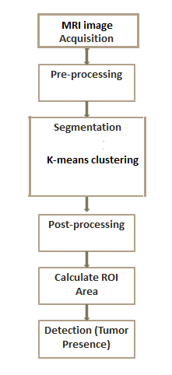
FLOW DIAGRAM

Slide 8
IMPLEMENTATION
The system can be divided into three modules based on their process. They are
Acquiring image
Clustering the image
Calculating tumor area
REQUIREMENTS:
MATLAB SOFTWARE
500GB RAM
MINIMUM i3 PROCESSOR

Slide 9
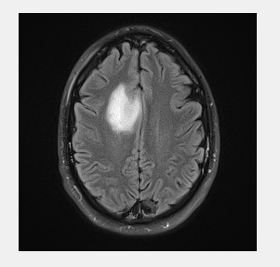
INPUT IMAGE

Slide 10
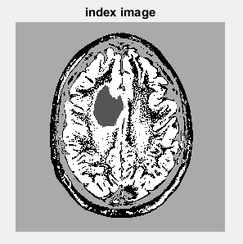
LEVEL ONE SEGMENTATION

Slide 11
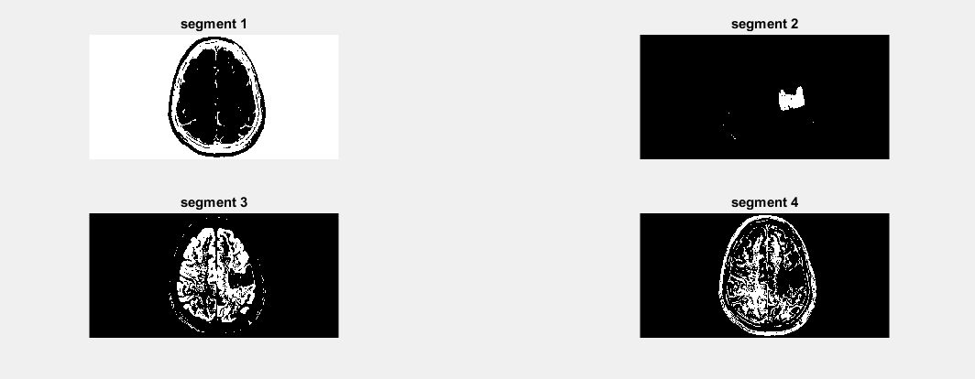
LEVEL TWO SEGMENTATION

Slide 12
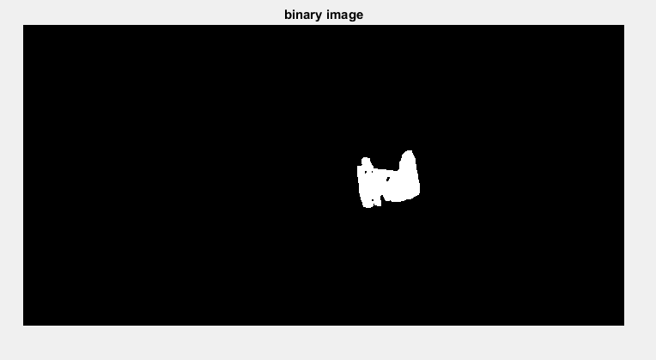
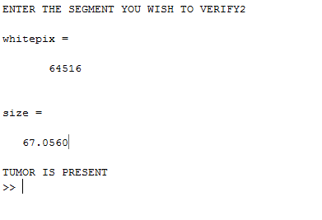
FINAL OUTCOME
Product A
Product B
Feature 1
Feature 2
Feature 3
Feature 1
Feature 2
Feature 3

Slide 13
CONCLUSION
This paper serves as a base for several applications
It can be combined with several other algorithms easily and can be checked for further future reference.
This algorithm can be used for several other applications in image segmentation rather than brain alone.
It can provide higher resolution and accuracy when combined with morphological and several other segmentation techniques.
To overcome the drawbacks, several techniques are combined to provide more accurate results.

Slide 14
THANK YOU!!

